Slide 1

Diabetes Prediction

Slide 2
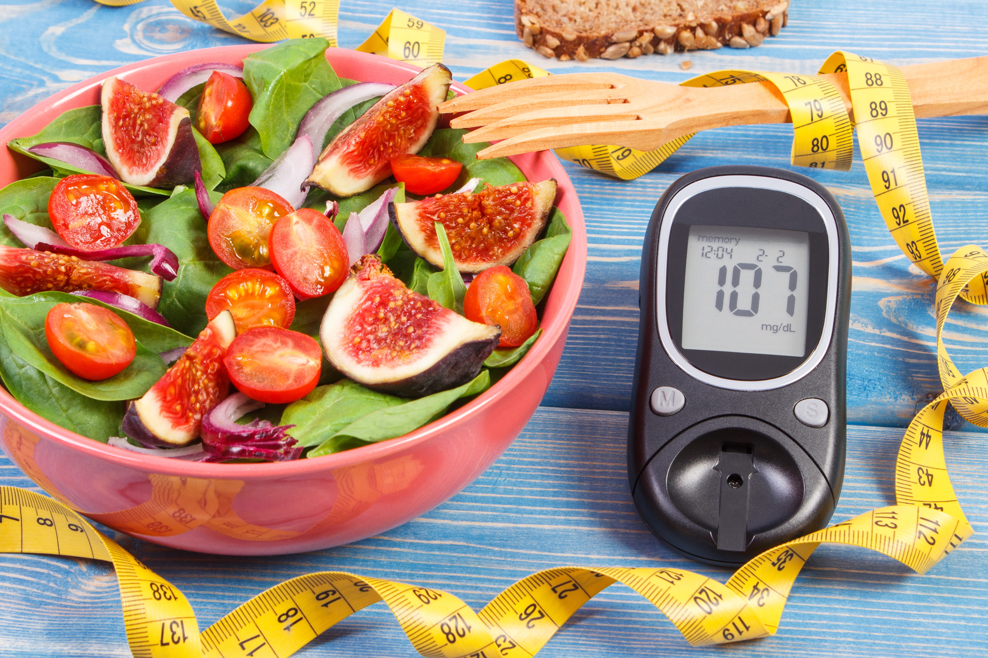
Diabetes Classifier
Building a machine learning classifier model for diabetes
Diabetes
Based on medical diagnostic measurements

Slide 3
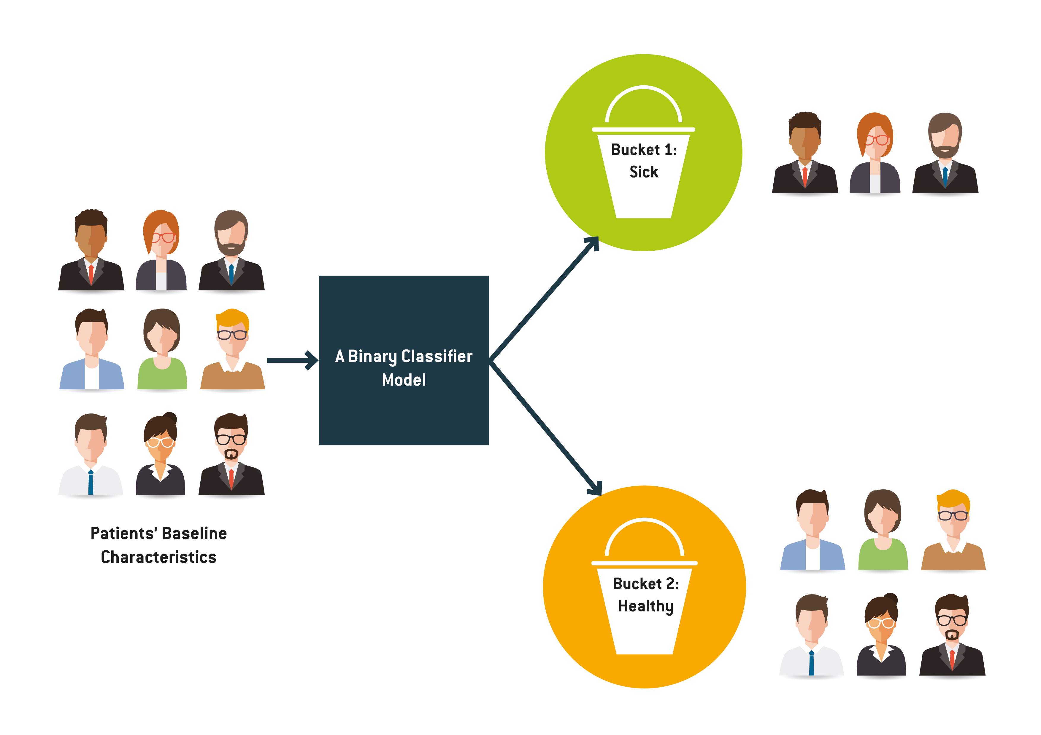



Objective
To build a predictive machine learning model to predict based on diagnostic measurements whether a patient has diabetes
No Diabetes
Classifier
Model
Patients’ medical
predictor variables
Diabetes

Slide 4

Dataset
Our dataset is Diabetes Prediction.
We are creating a simple model for predicting whether a person has diabetes or not.
This dataset contains various medical predictor variables and one target variable.
Dataset also contains number of pregnancies the patient has had, their BMI, insulin level, age and more.
Goal:
Our end goal of this project is that our model will predict a person has diabetes or not.

Slide 5
Features
Variables | Description
Pregnancies | Number of times pregnant
Glucose | Plasma glucose concentration in an oral tolerance test
Blood Pressure | Diastolic blood pressure (mm Hg)
Skin Thickness | Triceps skinfold thickness(mm)
Insulin | Two hour serum insulin
BMI | Body Mass Index
Diabetes Pedigree Function
Age | Age In years
Outcome | Class variable(0 or 1)

Slide 6
Task to perform
Data Exploration
In this dataset first and the most important task is data exploration.
Understanding the variables and their corresponding values.
We will perform descriptive analysis.

Slide 7
Data Modelling
We will plan a strategies for model building.
It is important to decide the right validation framework.
Express a thought process.
We will compare these models and decide which is more significant for prediction.
Model used:
For this dataset we have used different models such as Decision Tree, KNN,
Random Forest, Logistic Regression.

Slide 8
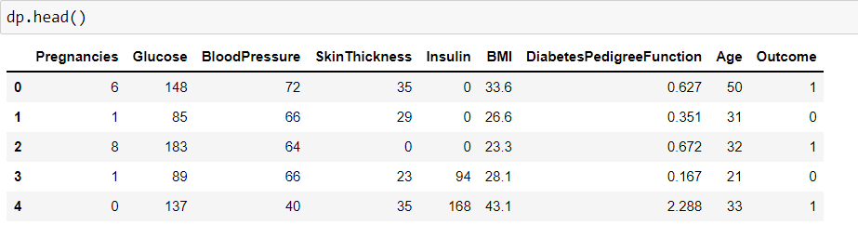
Analysing dataset
We can get a brief about the data by head command

Slide 9
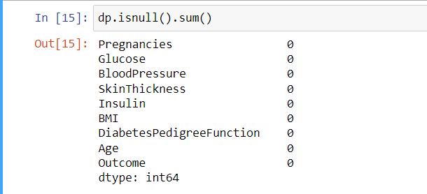
Data Cleaning
Now we will start the data cleaning process which plays a major role in any analysis.
We will find the null values in our dataset.

Slide 10
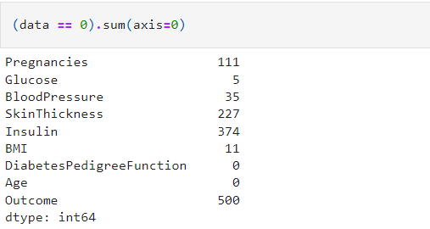
Now we will find the value ‘0’ in the dataset.
Here value ‘0’ indicates the missing value in our dataset.
We can find this by applying a condition “== 0”.
We can see that the value ‘0’ is present in columns where input is necessary.
The value 0 doesn’t make any sense in the columns:
Glucose, Blood Pressure, Skin Thickness, Insulin, BMI.

Slide 11
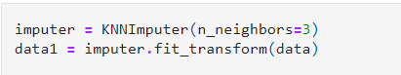
Replacing the values
Replacing the NaN value with mean might not be the most effective way to replace the value because it is a healthcare data. Therefore, we will use KNN Imputer.
KNNImputer : It is a method to impute the missing values.
It identifies the samples in a dataset which are nearest or close in the space.

Slide 12
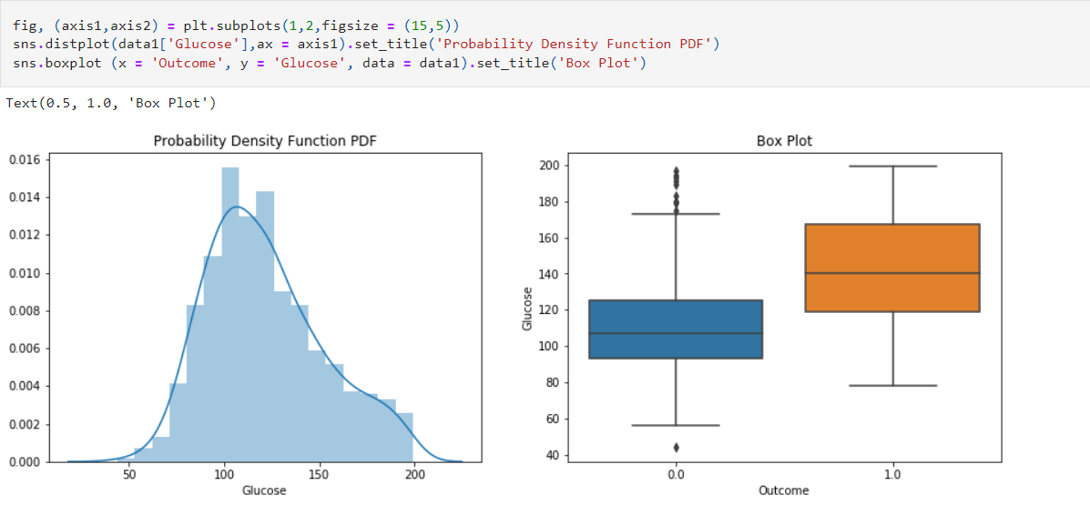
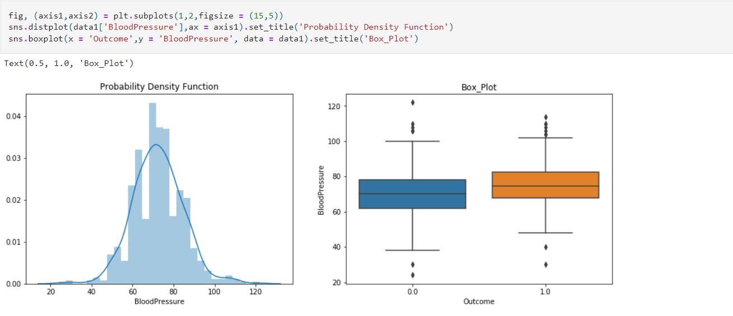
Outliers: Now we will check how many outliers are present in individual columns
Glucose
Blood Pressure

Slide 13
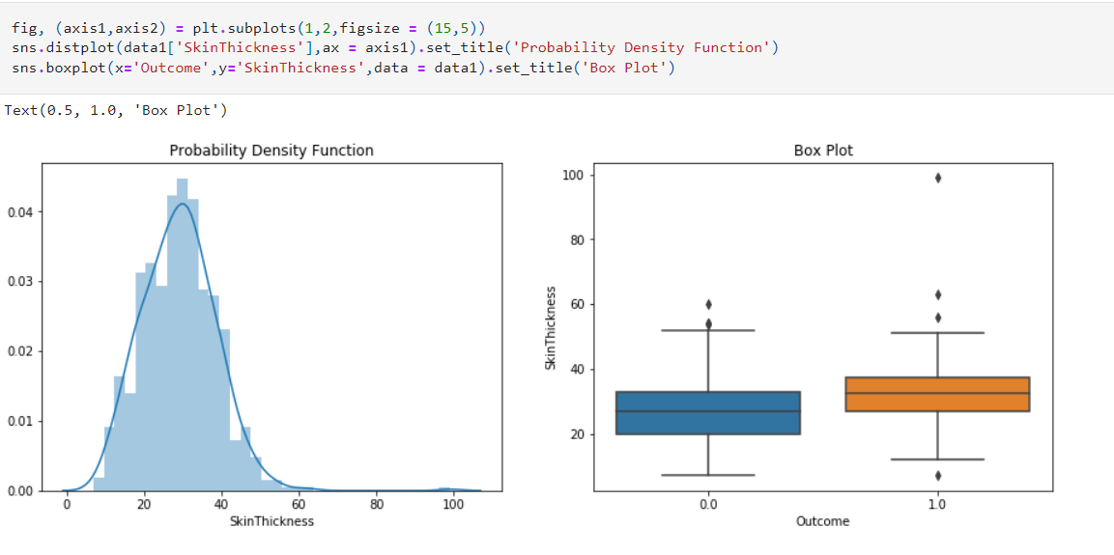
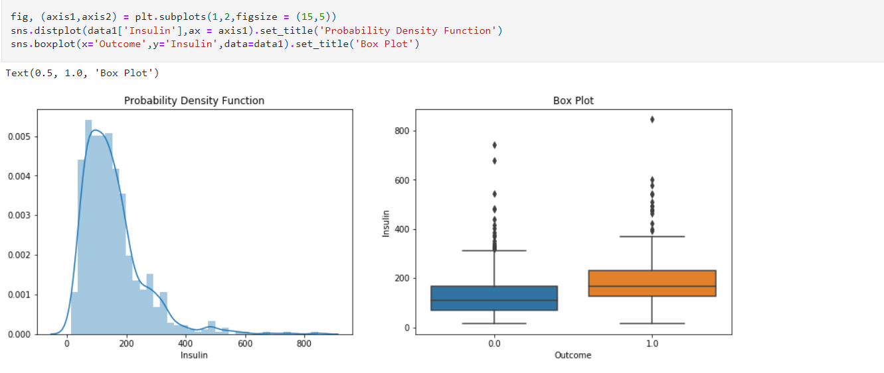
Skin Thickness
Insulin

Slide 14
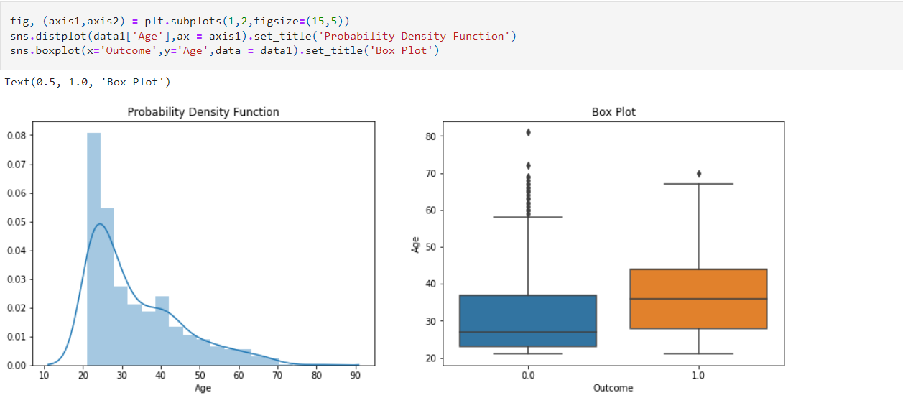
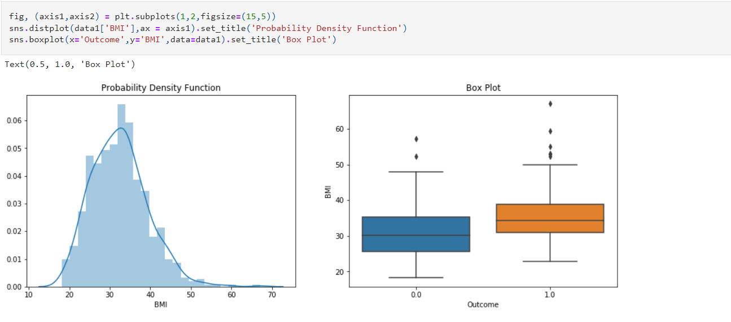
Age
BMI

Slide 15
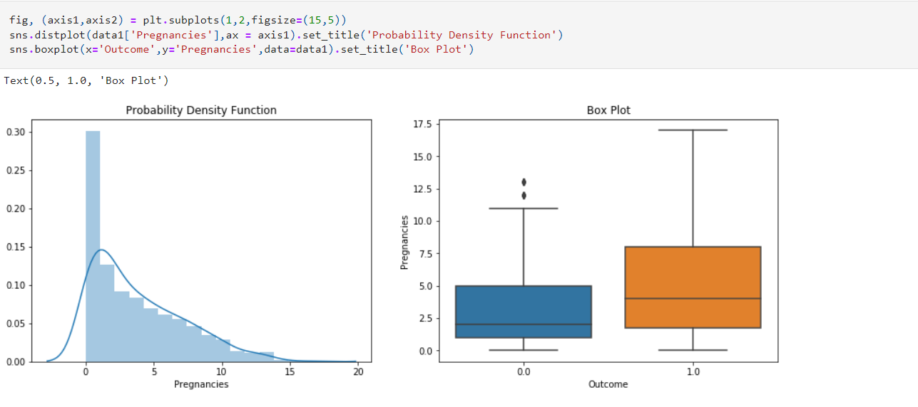
Pregnancies

Slide 16
Observation:
We have noticed that people with very high glucose level are more likely to have diabetes.
We have also noticed that blood pressure does not have significant relation with the outcome.
Old people are more likely to have diabetes.
Chances of diabetes increases with the number of pregnancies.

Slide 17
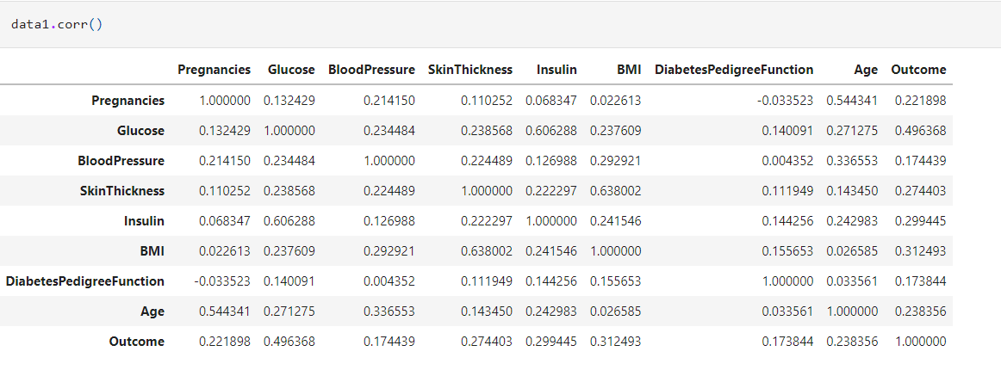
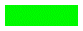
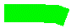
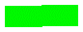
Finding correlation
Now we will find the correlation between the variables.
In order to find out correlation more precisely we will perform correlation analysis.

Slide 18
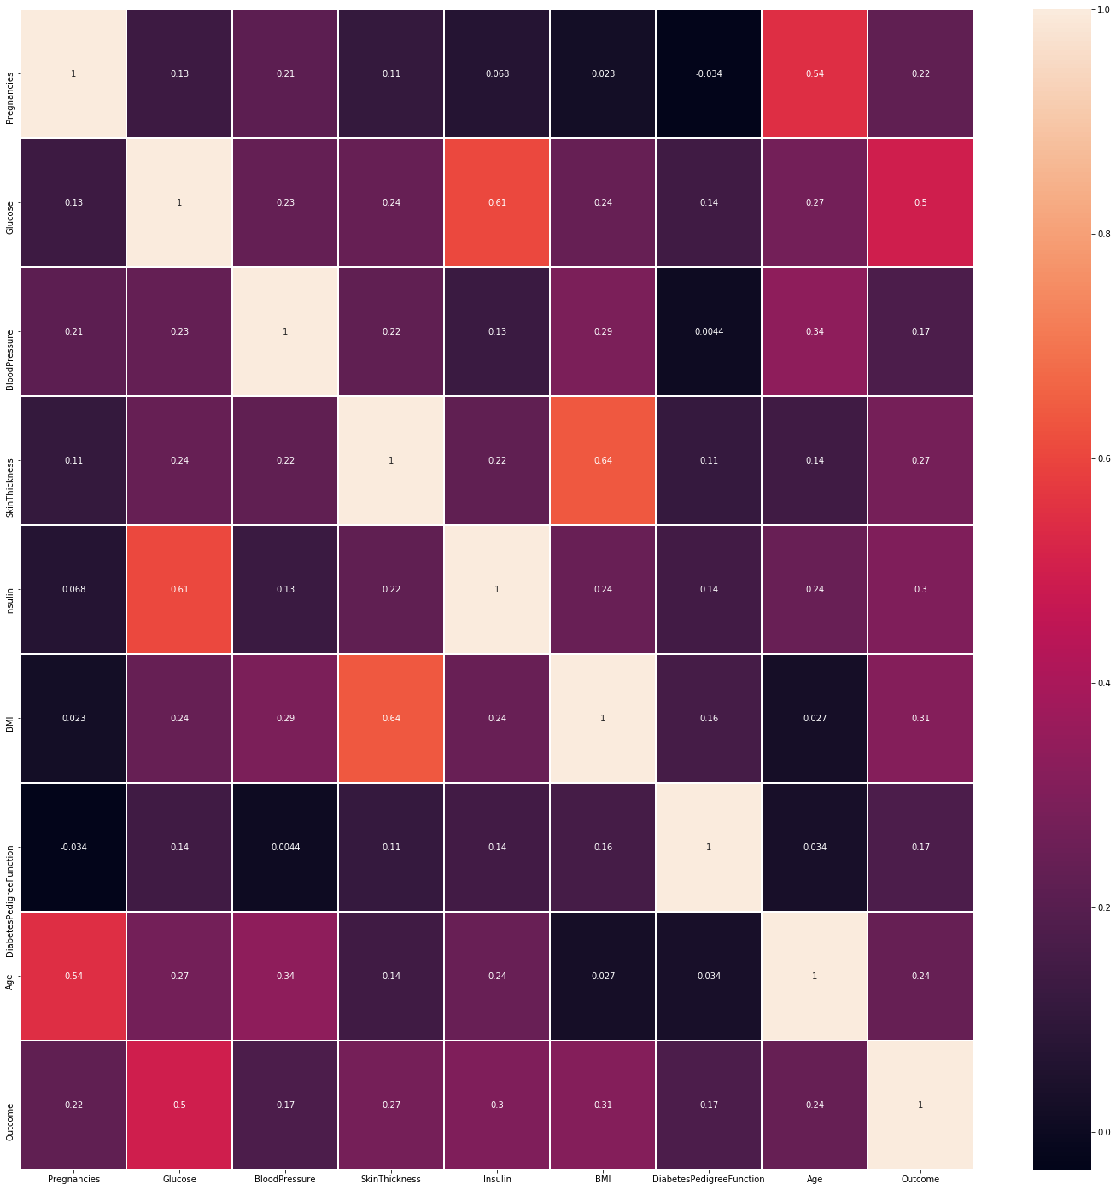
Heatmap
We have also generated Heatmap to understand the data better.

Slide 19
Observation:
As the BMI increases the Skin Thickness and cases of diabetes tends to increase also.
As Glucose increases most of the insulin ranges from 0-500.
Though the insulin ranges from 0-500 as glucose level increases chances of Diabetes also increases.

Slide 20
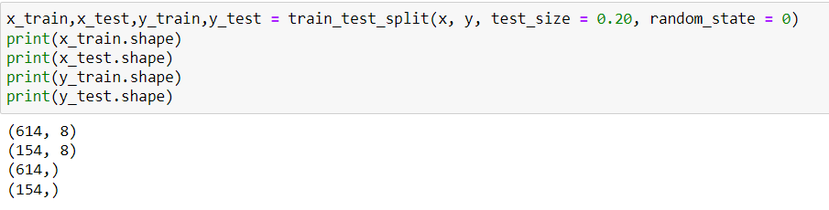
Split the data
Now we will split the data into train and test.
For that we will import the train and test from a library called “sklearn.model_selection”.

Slide 21
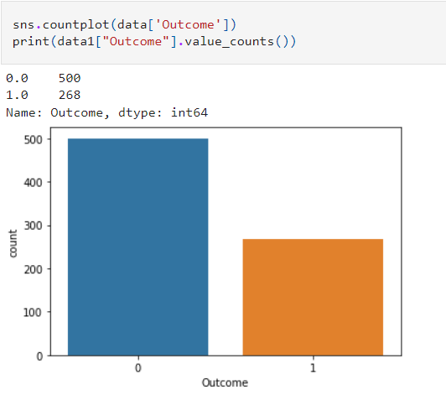
Checking Data Balancing
Before data modelling we have to check if the “Outcome” variable is balanced or not.
Here, 0 means Diabetes was not present and 1 means Diabetes was present.
As we can see in the graph data is imbalanced.
Because the data is imbalance the model will predict the wrong outcome.
Therefore, data balancing comes in the picture.

Slide 22
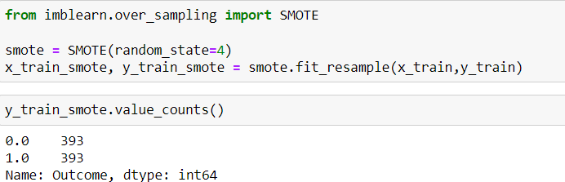
Data Balancing
For balancing the data we are using SMOTE(Synthetic Minority Over Sampling) method.
By using SMOTE it will create a synthetic data for balancing the data.
As we can see in the picture that data is balanced now.

Slide 23
Data Modelling
The performance metrics used in the evaluation are: · Accuracy Score: proportion of correct predictions out of the whole dataset
· Precision Score: proportion of correct predictions out of all predicted diabetic cases. · Recall Score: proportion of correct predictions out of all actual diabetic cases. · F1 Score: optimised balance between Precision and Recall for binary targets. · Area Under ROC Curve: prediction scores from area under Receiver Operating Characteristic (ROC) curve, which is a relationship between True Positive Rate and False Positive Rate. · Log Loss: Log-loss is indicative of how close the prediction probability is to the corresponding actual/true value (0 or 1 in case of binary classification). The more the predicted probability diverges from the actual value, the higher is the log-loss value.
Now lets start the data modelling part.
For this dataset we are using:
Decision Tree
Random Forest
Logistic Regression
KNN(K-Nearest Neighbour)

Slide 24
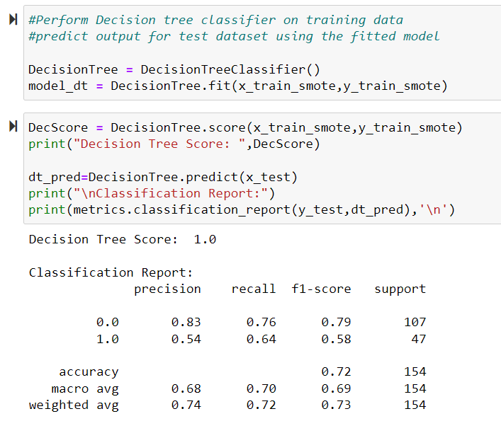
Decision Tree
We are performing Decision Tree classifier on training model.
Macro is simply the arithmetic mean of the individual scores.
weighted includes the individual sample sizes.

Slide 25
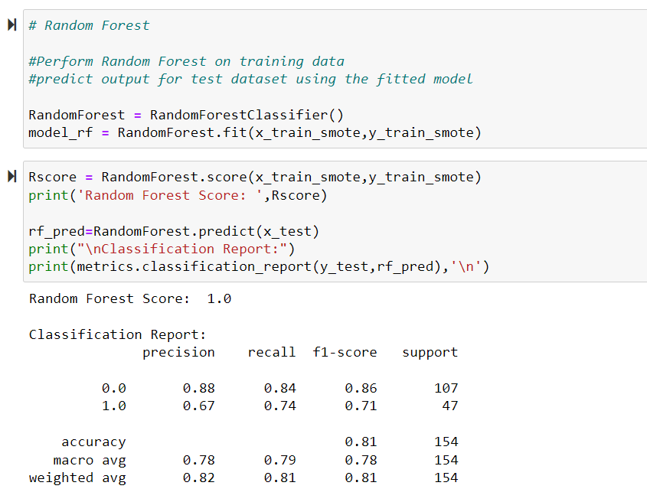
Random Forest
Performing a Random Forest on training data

Slide 26
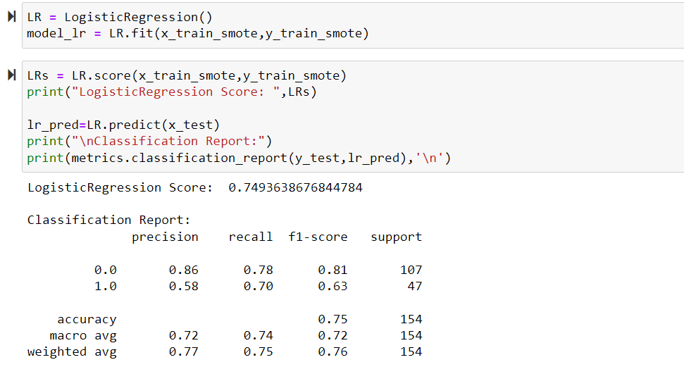
Logistic Regression
Performing a Logistic Regression on training data

Slide 27
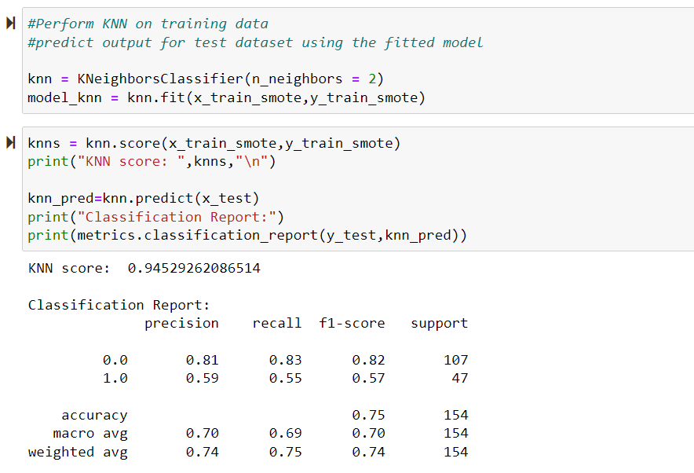
KNN(K-Nearest Neighbour)
Performing KNN on training data

Slide 28
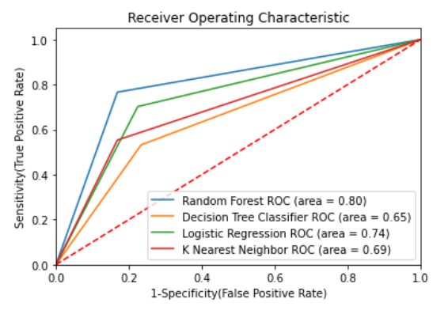
Plotting a model
Now we will plot the model to get the idea about which model is best for out dataset to predict the outcome.

Slide 29
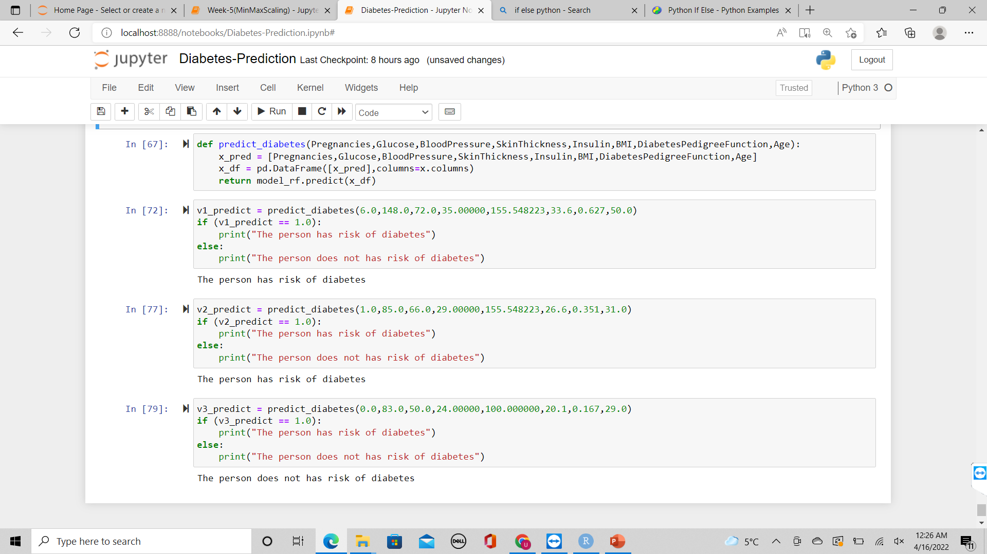
Predicting User Defined Value
To predict values given by user, we have created and used predict_diabetes function

Slide 31

THANK YOU

